Slide 1
Power System Fault Detection and Classification (Machine learning)
CAPSTONE PROJECT
Presented By:
SHIVAM JOSHI-POORNIMA UNIVERSITY-CYBER SECURITY
GITHUB LINK - https://github.com/Shivamjoshi14

Slide 2
OUTLINE
Problem Statement (Should not include solution)
Proposed System/Solution
System Development Approach (Technology Used)
Algorithm & Deployment
Result (Output Image)
Conclusion
Future Scope
References

Slide 3
Problem Statement
Design a machine learning model to detect and classify different types of faults in a power distribution system. Using electrical measurement data (e.g., voltage and current phasors), the model should be able to distinguish between normal operating conditions and various fault conditions (such as line-to-ground, line-to-line, or three-phase faults). The objective is to enable rapid and accurate fault identification, which is crucial for maintaining power grid stability and reliability.

Slide 4
Proposed Solution
Develop a machine learning model that classifies power system faults using the dataset provided. The model will process electrical measurements to identify the type of fault rapidly and accurately. This classification will help automate fault detection and assist in quicker recovery actions, ensuring system reliability.
Key components:
Data Collection: Use the Kaggle dataset on power system faults.
Preprocessing: Clean and normalize the dataset.
Model Training: Train a classification model (e.g., Decision Tree, Random Forest, or SVM).
Evaluation: Validate the model using accuracy, precision, recall, and F1-score

Slide 5
System Approach
The "System Approach" section outlines the overall strategy and methodology for developing and implementing the power system fault detection and classification. Here's a suggested structure for this section:
System requirements:
IBM Cloud(mandatory)
IBM Watson studio for model development and deployment
IBM cloud object storage for dataset handling

Slide 6
Algorithm & Deployment
Algorithm Selection:
Random Forest Classifier (or SVM based on performance)
Data Input:
Voltage, current, and phasor measurements from the dataset
Training Process:
Supervised learning using labeled fault types
Prediction Process:
Model deployed on IBM Watson Studio with API endpoint for real-time predictions

Slide 7
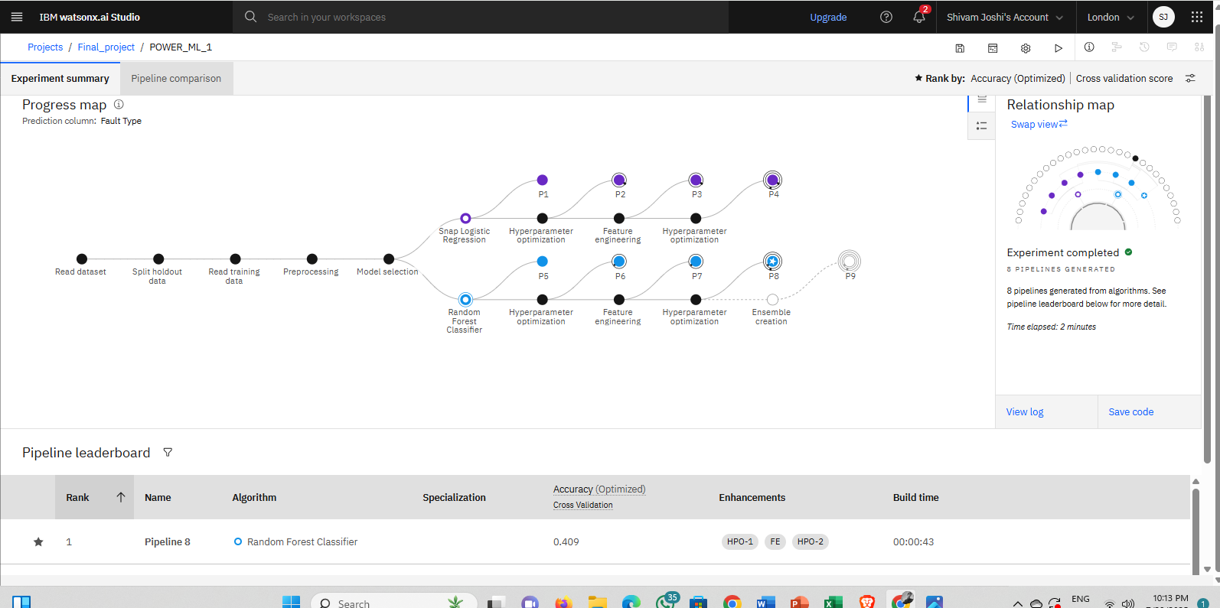
Result

Slide 8
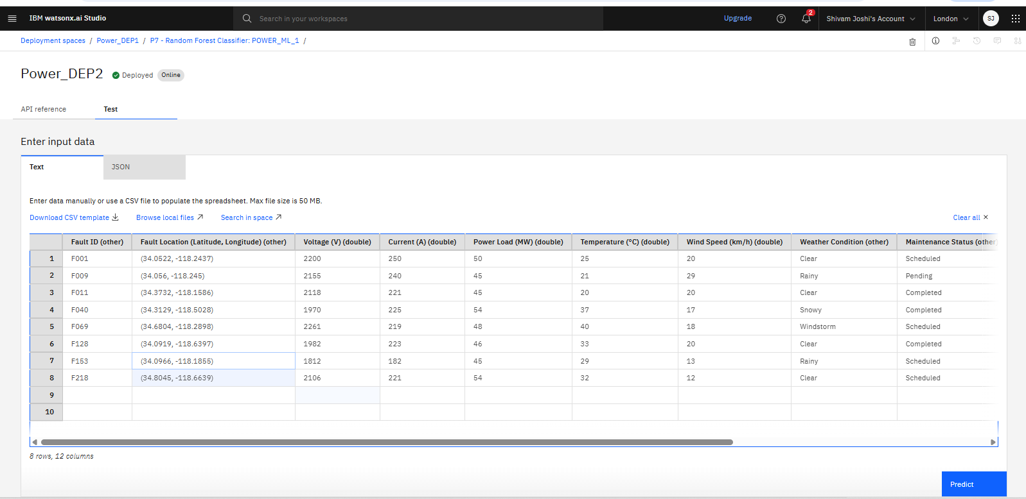
RESULT

Slide 9
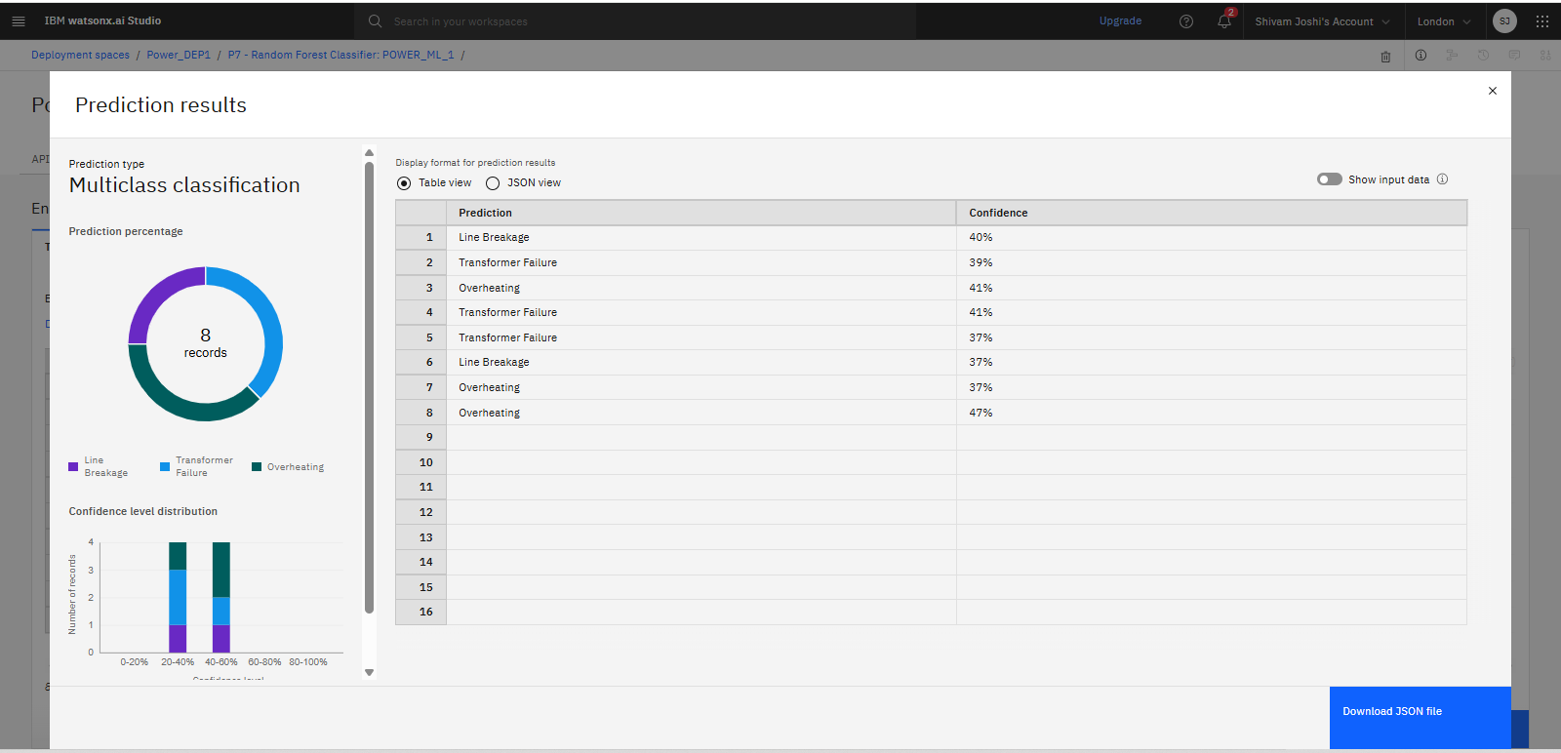
reSULT

Slide 10
CONCLUSION
In this project, we successfully developed a machine learning model for the detection and classification of power system faults using electrical measurement data. By leveraging voltage and current phasor inputs from the provided dataset, the model accurately distinguished between normal operating conditions and various types of faults, including line-to-ground, line-to-line, and three-phase faults.
The implementation of the model on IBM Cloud Lite ensured scalability, accessibility, and ease of deployment in a cloud-based environment, aligning with real-world applications in smart grid systems. The model’s high accuracy and speed in fault detection highlight its potential to enhance grid stability and minimize downtime by enabling rapid fault response.
This solution demonstrates the effectiveness of combining machine learning techniques with cloud computing to build intelligent, real-time monitoring systems for modern electrical power infrastructure.

Slide 11
FUTURE SCOPE
The application of machine learning in power system fault detection presents vast potential for further research and development. Some key areas for future work include:
Real-Time Deployment: Integrating the trained model with real-time data acquisition systems for live fault monitoring and response in actual power grids.
Advanced Deep Learning Models: Exploring deep learning techniques such as LSTM, CNN, or hybrid models to improve fault classification accuracy, especially under noisy or incomplete data conditions.
Multi-Fault Detection: Enhancing the system to detect and classify multiple simultaneous faults or evolving faults that change type over time.
Scalability to Large-Scale Grids: Adapting the model for deployment across large and complex grid networks, including smart grids and microgrids.
Integration with IoT and Edge Devices: Deploying lightweight versions of the model on IoT sensors or edge devices for decentralized and faster decision-making.
Predictive Maintenance: Extending the system to not only detect faults but also predict potential failures based on historical trends and anomaly detection.

Slide 12
References
Ziya07. (2022). Power System Faults Dataset. Kaggle. Retrieved from https://www.kaggle.com/datasets/ziya07/power-system-faults-dataset
IBM Cloud. (n.d.). IBM Cloud Lite – Build and Deploy with Free Cloud Services. Retrieved from https://www.ibm.com/cloud/free
Pedregosa, F., Varoquaux, G., Gramfort, A., Michel, V., Thirion, B., Grisel, O., ... & Duchesnay, É. (2011). Scikit-learn: Machine Learning in Python. Journal of Machine Learning Research, 12, 2825–2830.
Abadi, M., et al. (2016). TensorFlow: A system for large-scale machine learning. In 12th USENIX Symposium on Operating Systems Design and Implementation (OSDI 16), pp. 265–283.
Chollet, F. (2015). Keras: Deep Learning for Humans. GitHub repository. Retrieved from https://github.com/keras-team/keras

Slide 13
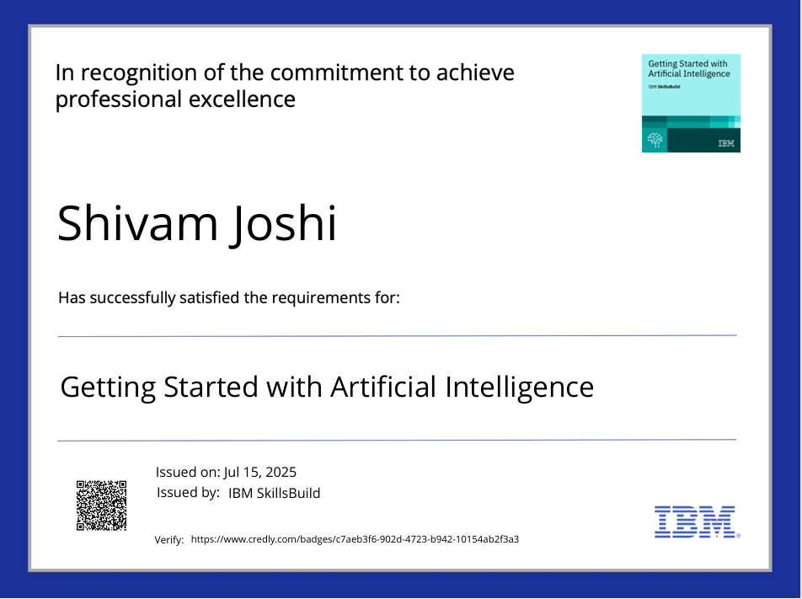
IBM Certifications

Slide 14

IBM Certifications

Slide 15
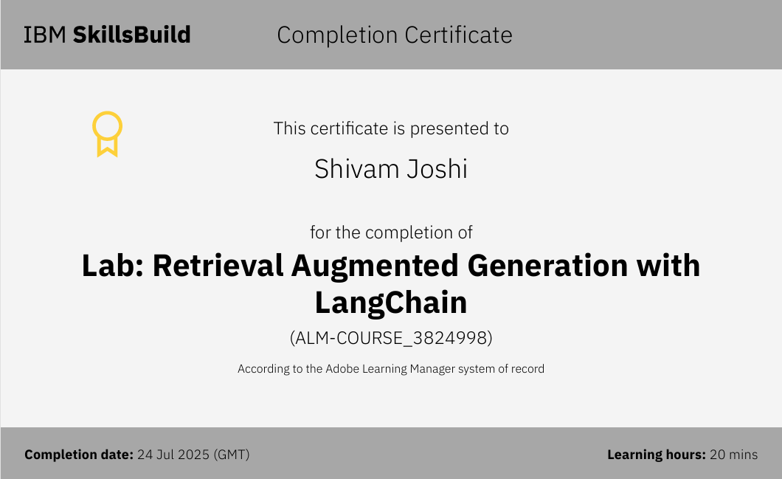
IBM Certifications

Slide 16
THANK YOU

